Slide 1
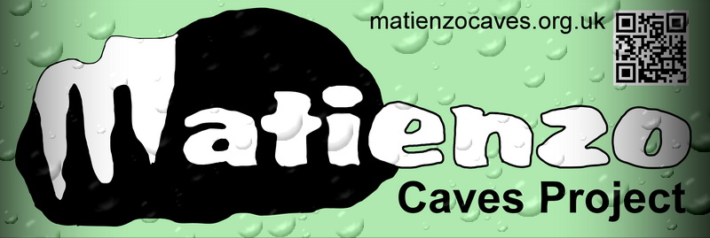
1: 2018 MCP Review (minus the explorations)
2: Entomology Project (Tom Thomson)
3: Update on the maps
4: New book – Matienzo Caves: 2010 - 2019

Slide 2
New personal details forms circulated and filled in. Checked this Easter.
Lots of feedback from Guy Simonnot - details of holes on the Arredondo side of the hill
Matienzo Karst Entomology Project Permit for collecting bugs in the caves in 2018 through to Easter 2019. Tom Thomson and Amata Hinkle
Lancaster University Climate and Neanderthal project completed. New project collecting stal and water samples for nitrogen analysis. Land use over hundreds of years.
Possible hypogene origin of some of the Vaca passages. Pete Smith

Slide 3
Matienzo Caves talk at the RGS is now online YouTube video
Water tracing - 3 caves connecting to the Santa Juliana resurgence on the north side of the Riaño-Entrambasaguas road
Alisas shaft #1969 sink to Fuente Aguanaz. 7km distance and 575m altitude drop.
Surveys Patrick Warren Inkscape extension produces a passage orientation rose diagram from any Survex 3d file.
Drone - DJI Mavic Pro 60 x 360deg aerial photos - Drone Pot discovered by comparing aerial photo with map – others to come? 32 video flyovers with a flight path to compare with sites on map

Slide 4
Web site - the interactive pages had to be re-written when the language used was upgraded on the web site server.
Cave Search facility and Log Book search - now open to everyone and not hidden behind a password.
The first page has also had a facelift with a "slide show"
Figures: With all the 2018 explorations - 730 updates to the 4855 website descriptions
IT Systems: 3 networked laptops & fileserver with backup used in Spain. Functioning OK.

Slide 5
MKEP Tom Thomson Monday 15th April – 1st May (Amata + Fergus)
Taking out long-term study traps installed via last year’s grant
from Oxford University which have been underground in 25 locations for just over a year.
Like to get involved with longer trips “could help in exchange for tagging along and sampling”, eg deeper trips into the 5 Valleys System.
Planning talks: t.thomson@nhm.ac.uk Telephone
Or mention on Matienzo Caves FaceBook page
Also looking for lift to (Santander?) port from someone sailing 1st May

Slide 6
MKEP Tom Thomson Monday 15th April – 1st May (Amata + Fergus)
New strand supported by British Entomological and Natural History Society:
Cave dwelling crustaceans and other related freshwater / streamway fauna
As many wet caves as possible (especially new areas of streamway) . People willing to take a small kids dipper net and collection pot in their pack and do a quick sweep of likely spots.

Slide 7
Maps
Matienzo QGIS map continues to be populated with more layers. This is used on the expeditions, by me and at least 2 other people. Layers on the map - often include points to click and activate other programs - eg cave descriptions, aerial videos, panoramic photos, passage altitudes. Layers can be visible or not:

Slide 8
Contours, permit area, area names
Surface features - roads, field boundaries etc
Entrance positions - click to show description
Cave centre lines - click to show x,y,z
Hydrology - click to show details
Dowsing lines - click to show details
Aerial videos coverage - click to play video
Aerial panoramas coverage - click to activate PanGazer and show panorama
Geology - click to show details of each unit
Digital terrain model
Satellite photos - 2010 and 2014, the latest available

Slide 9
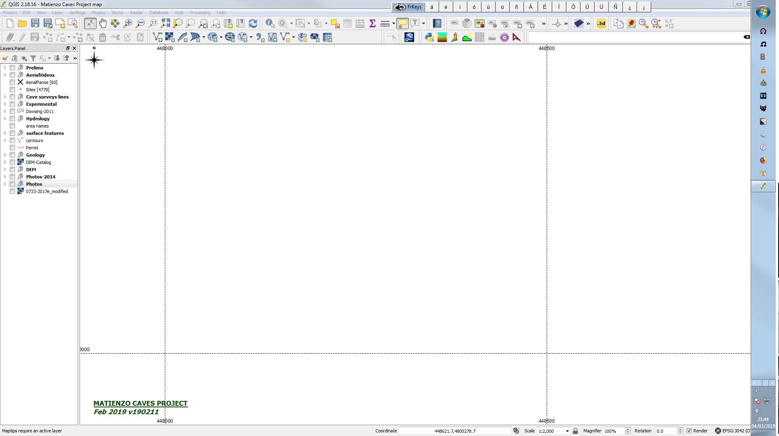

Slide 10
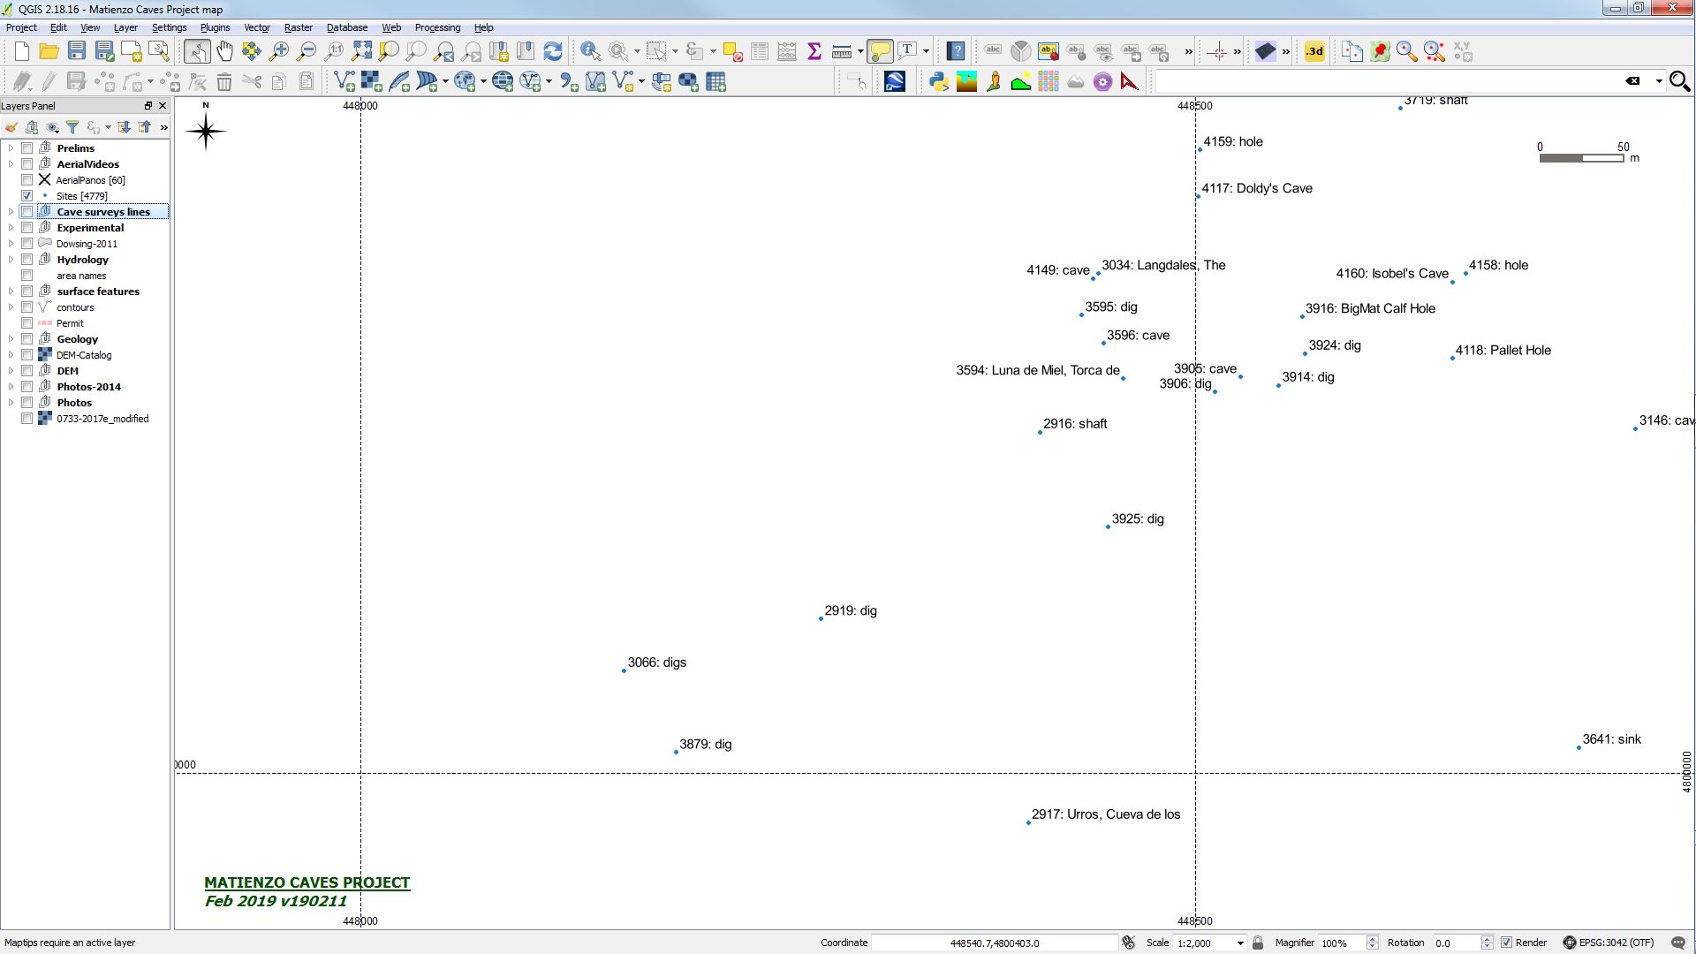

Slide 11
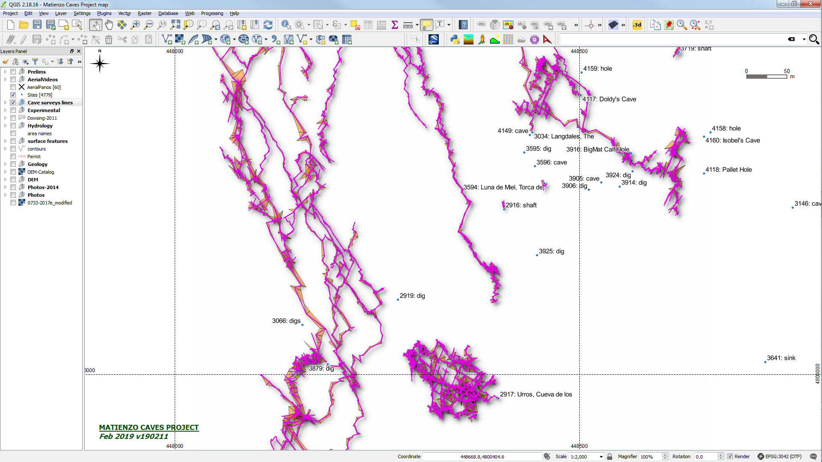

Slide 12
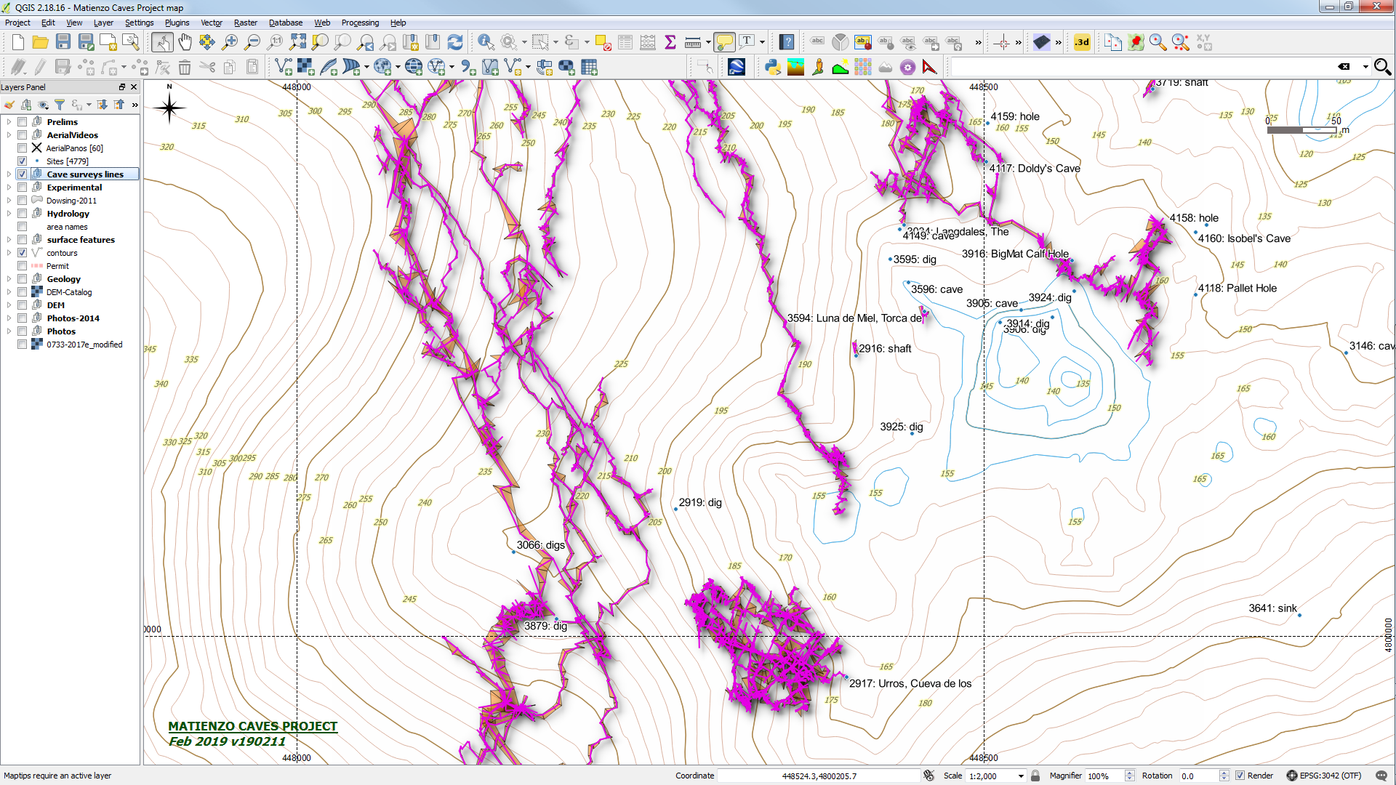

Slide 13
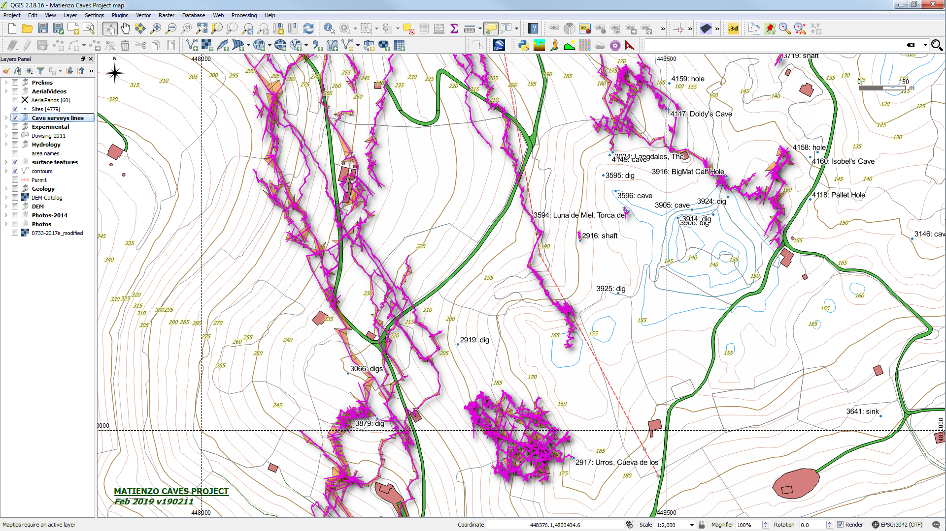

Slide 14
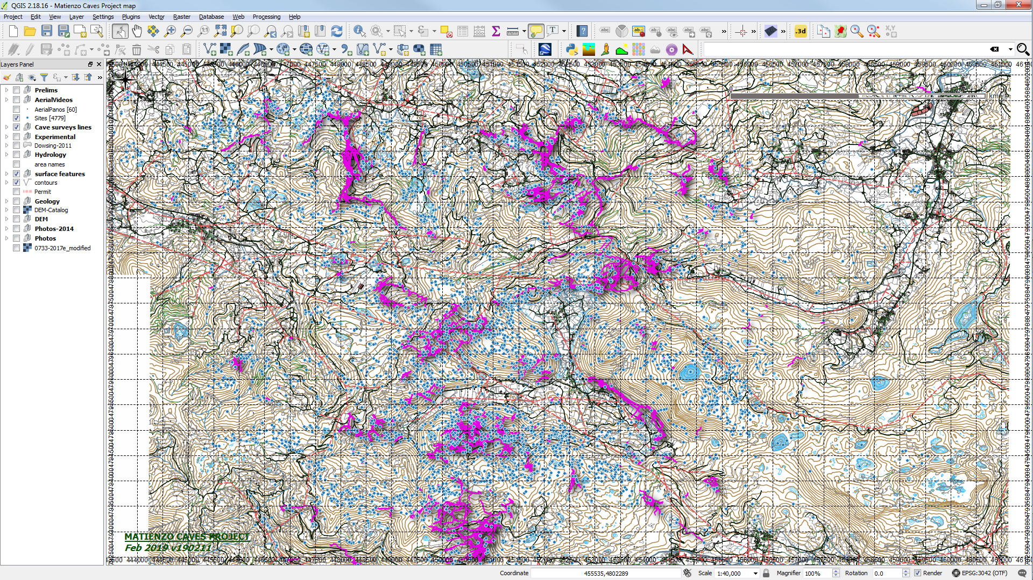

Slide 15
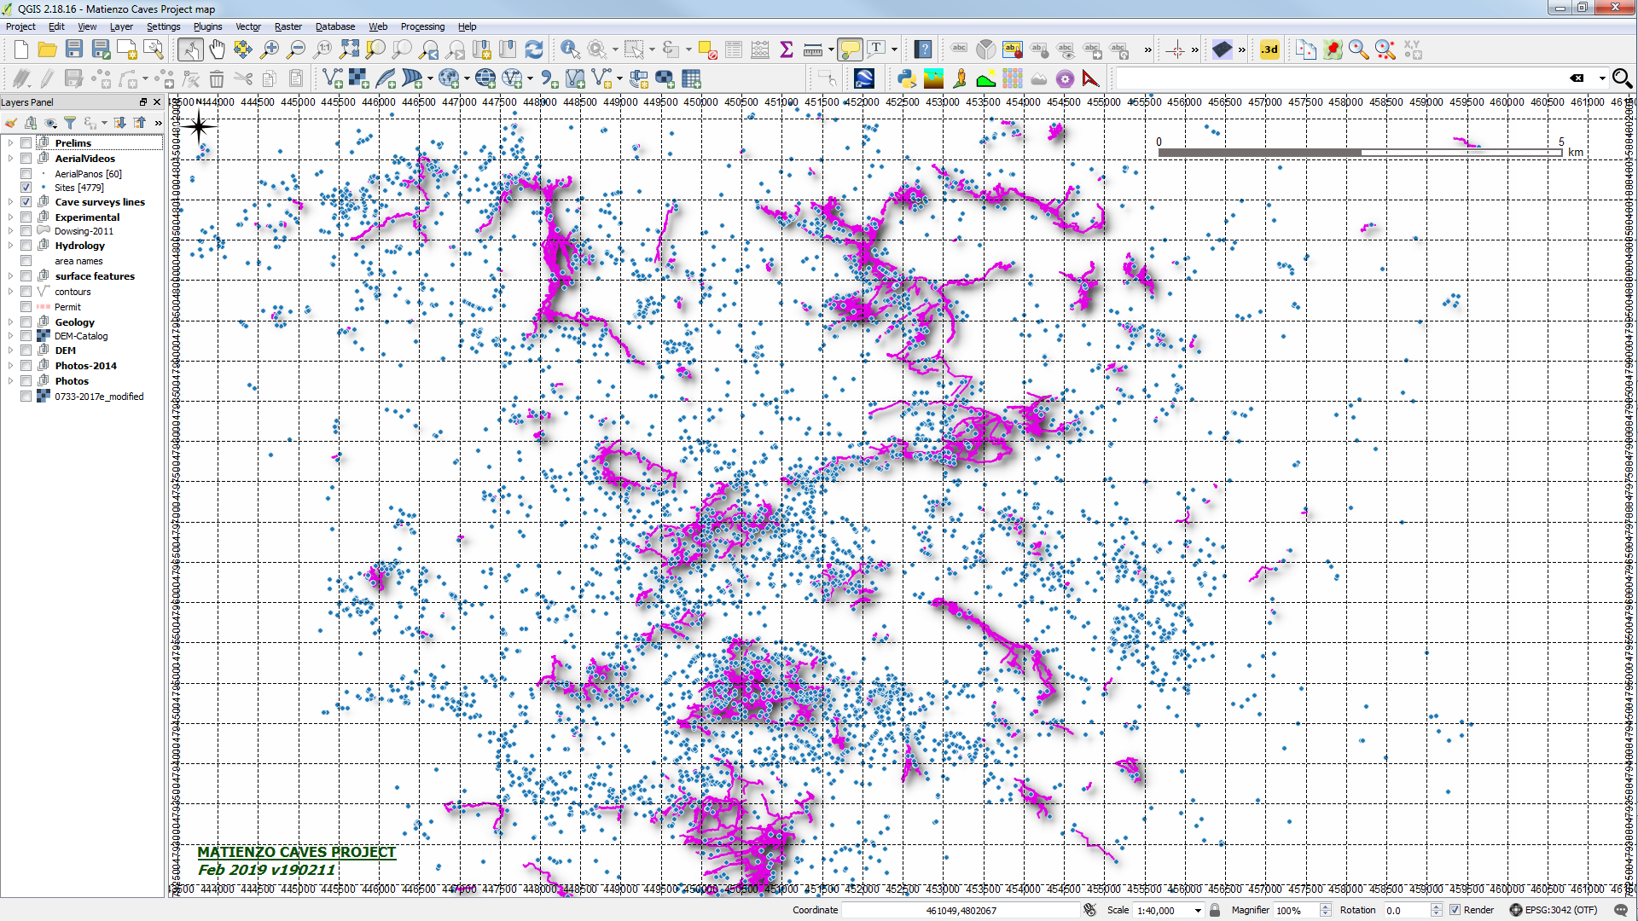

Slide 16
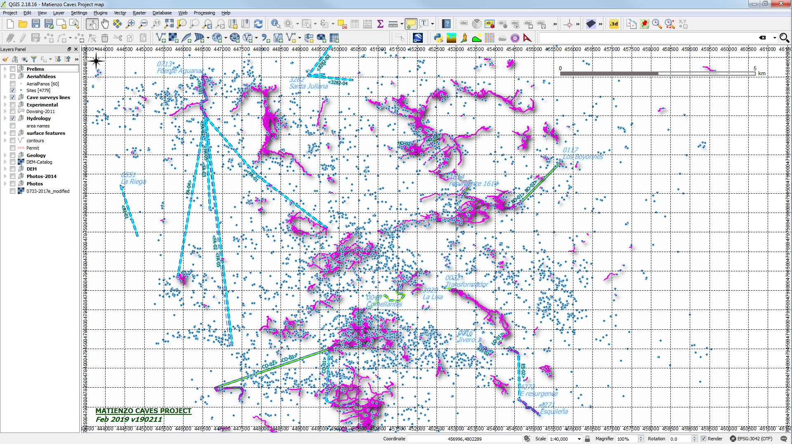

Slide 17
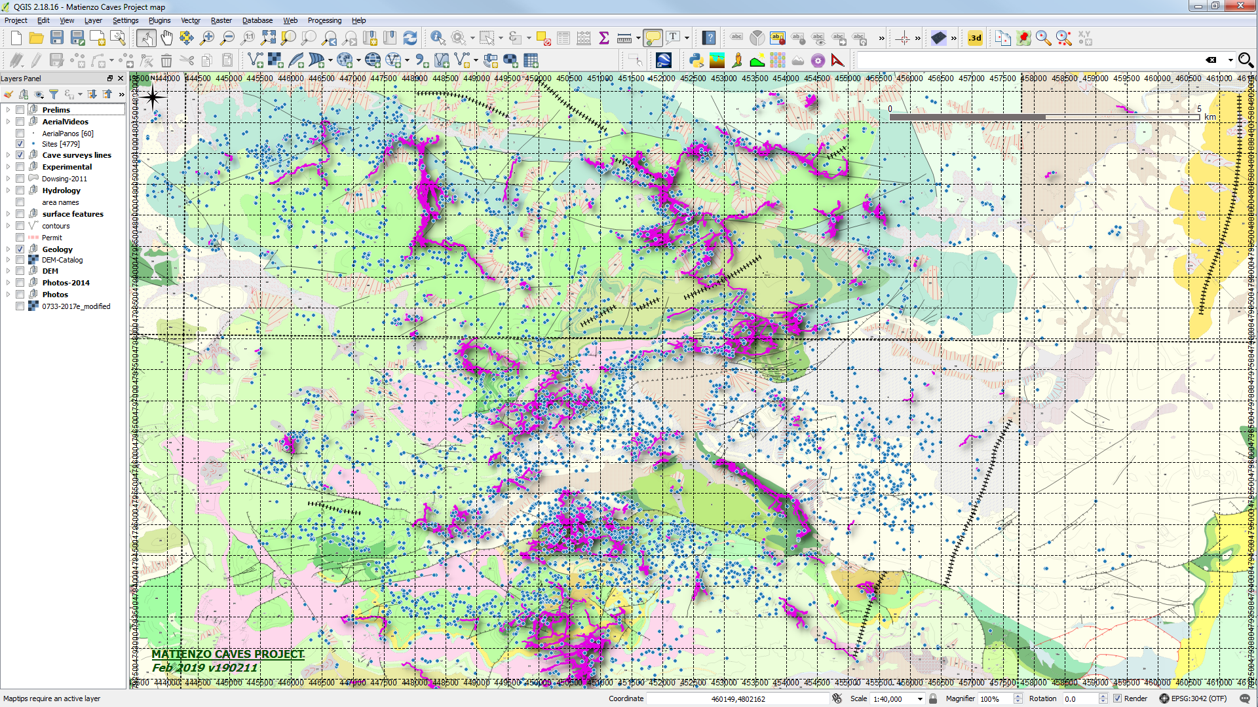

Slide 18
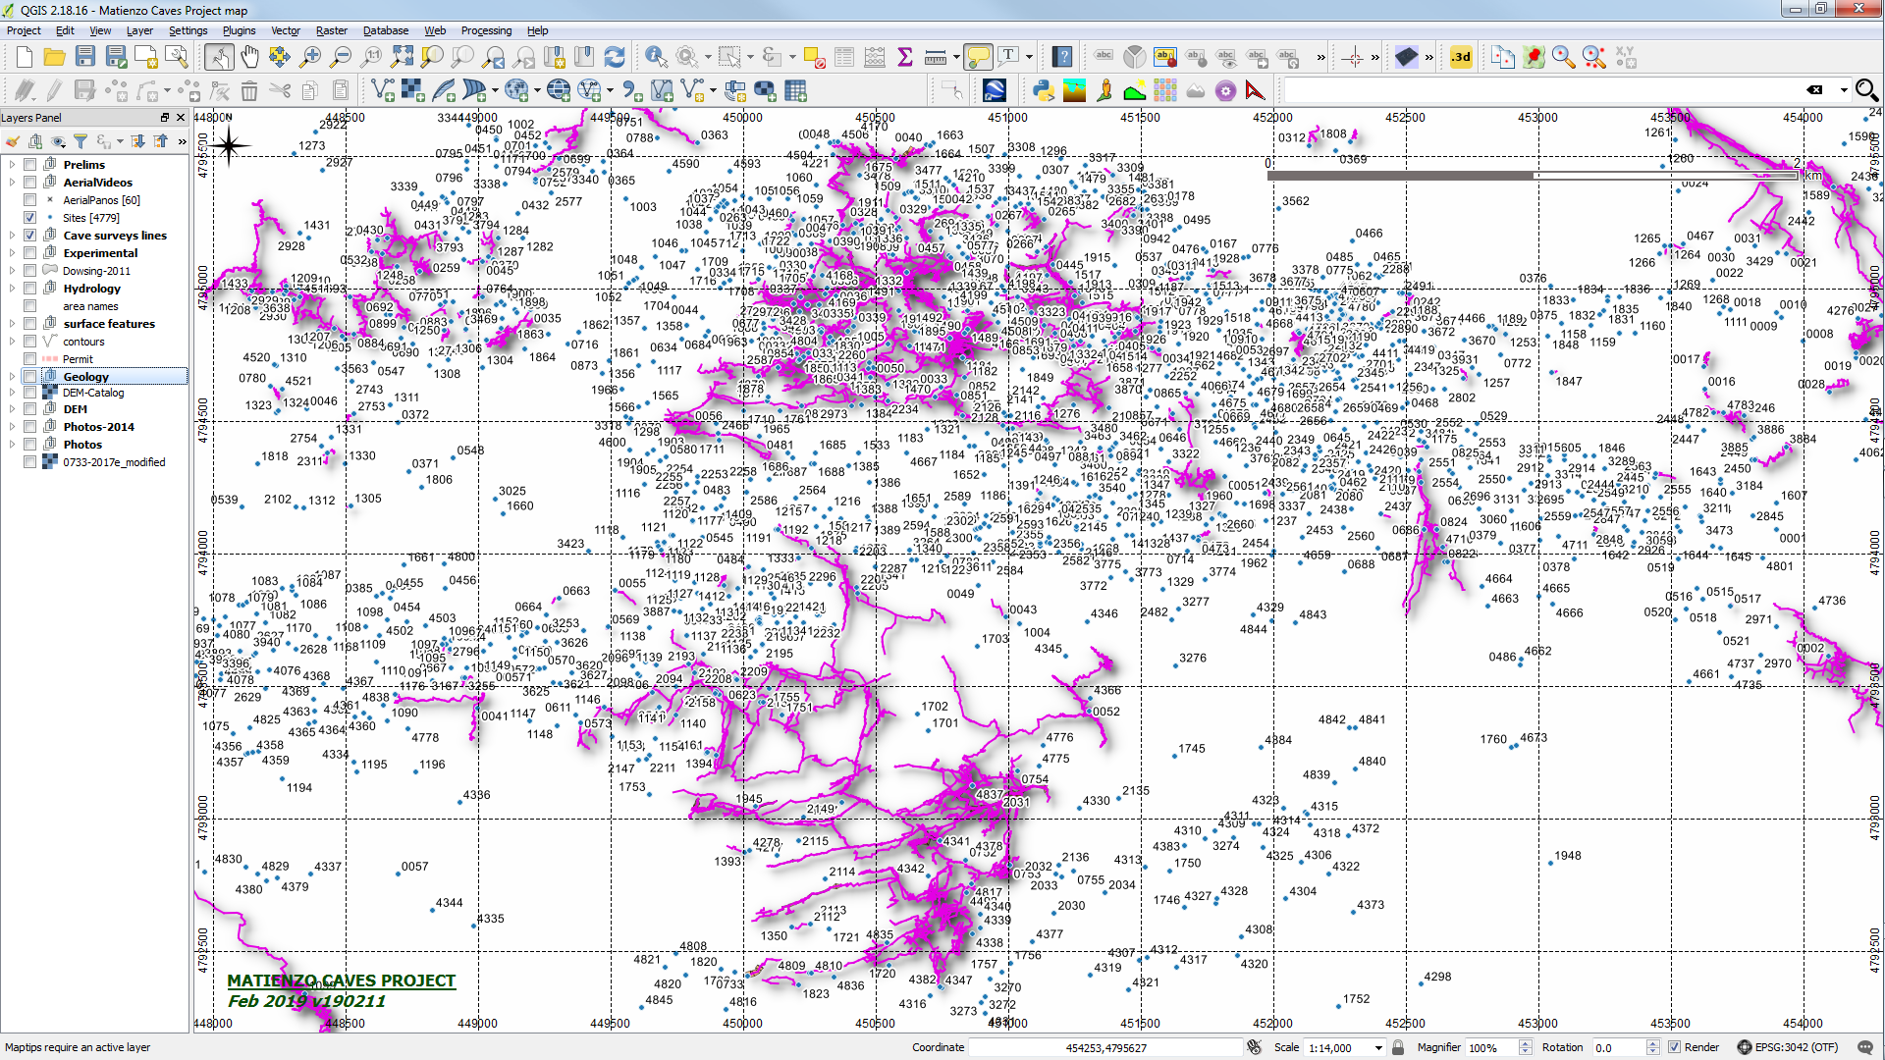

Slide 19
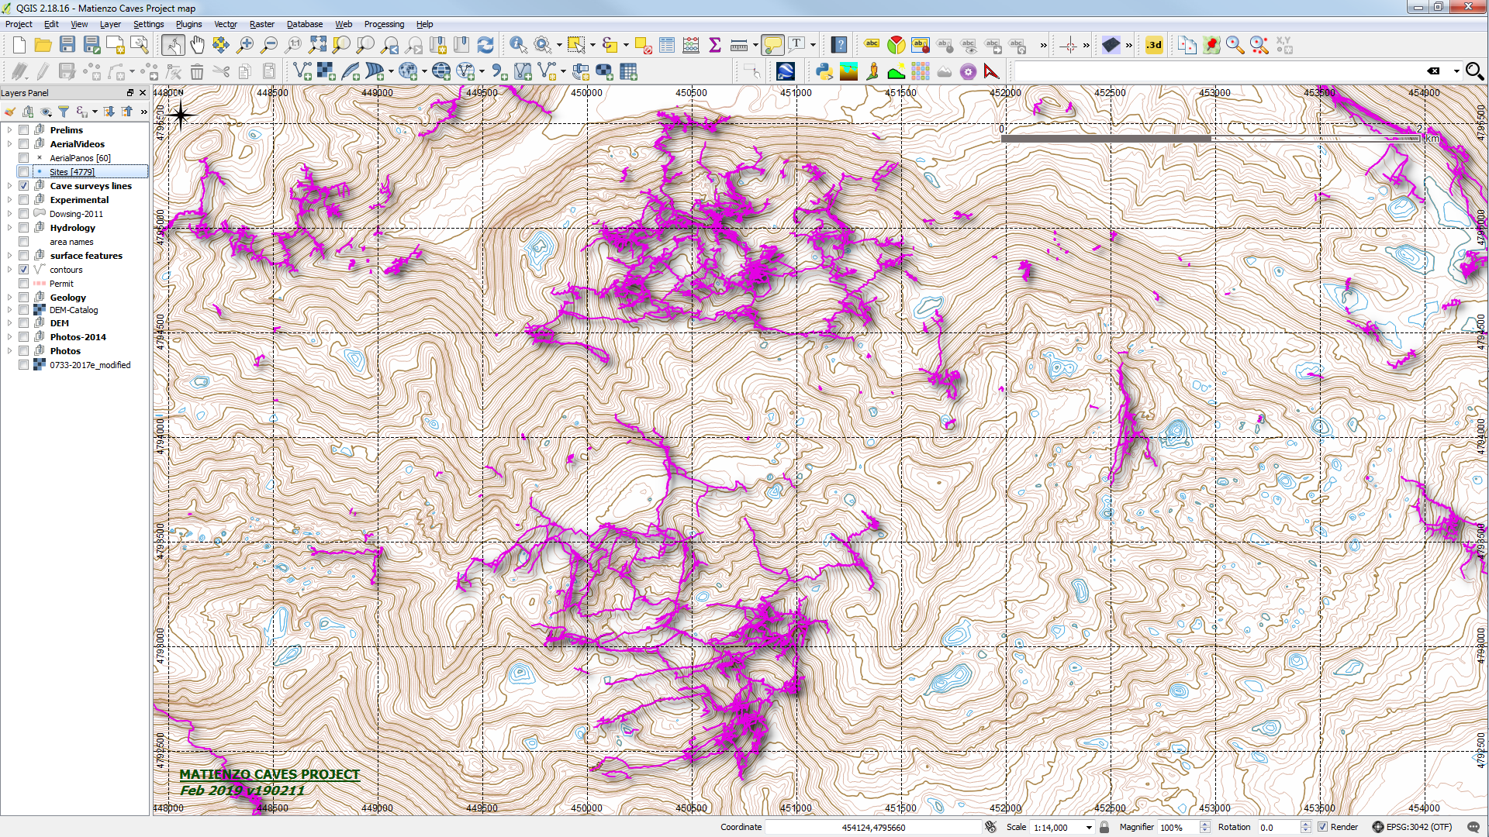

Slide 20
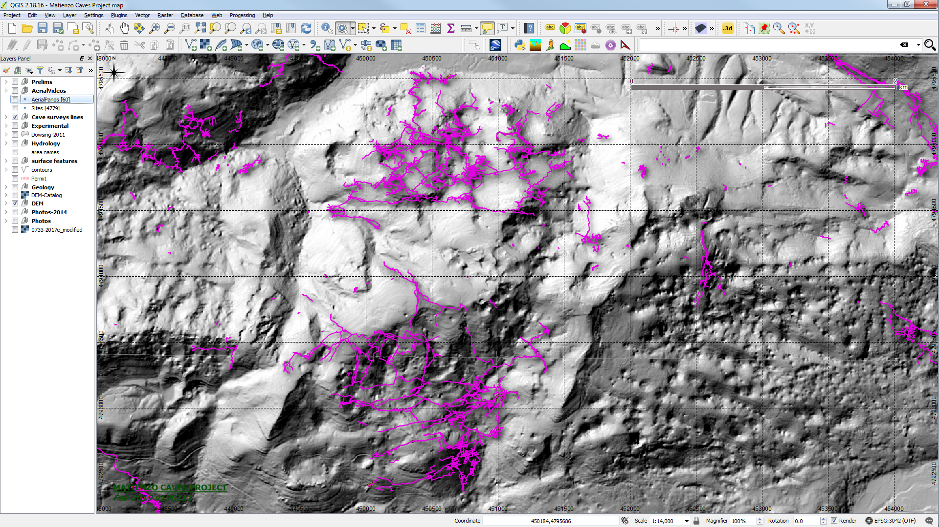

Slide 21
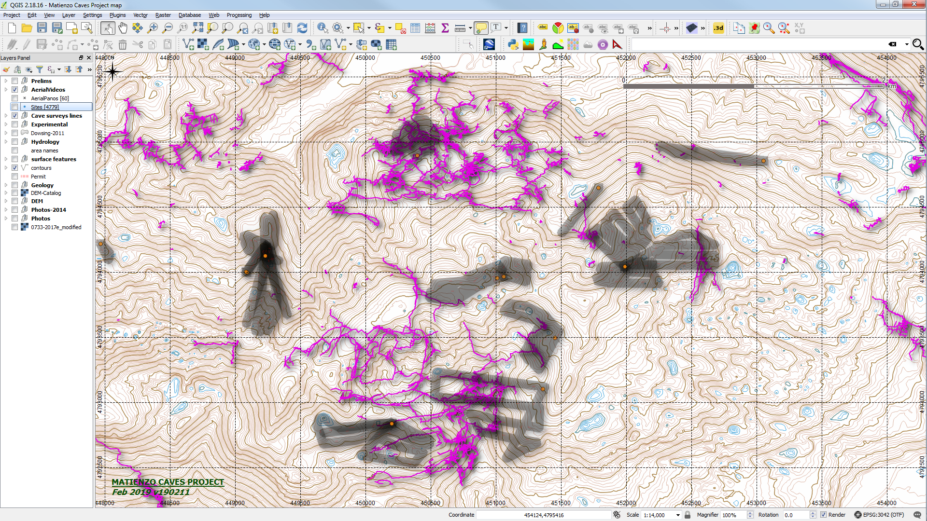

Slide 22
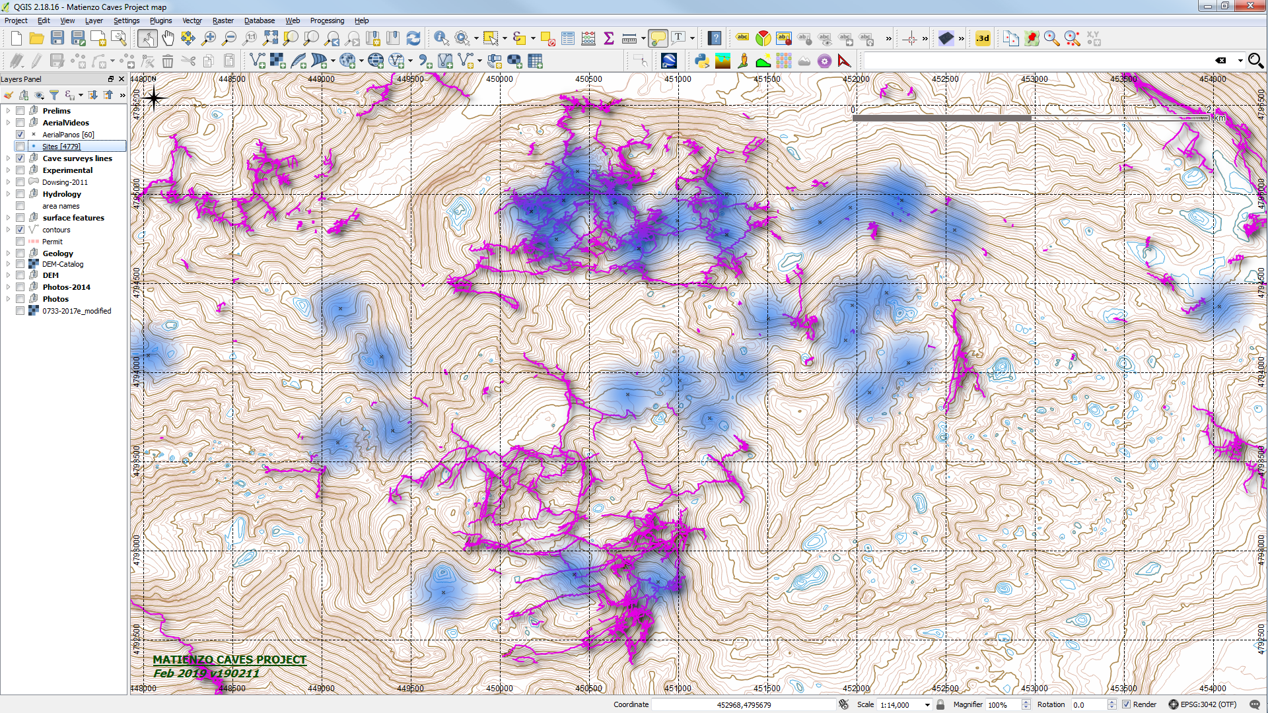

Slide 23
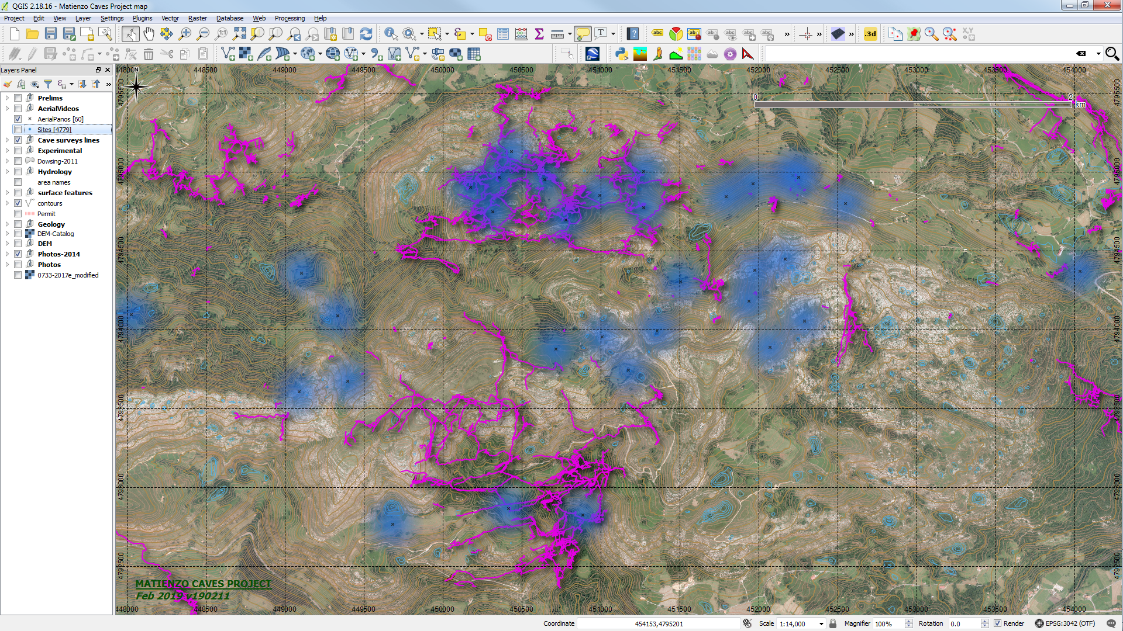

Slide 25
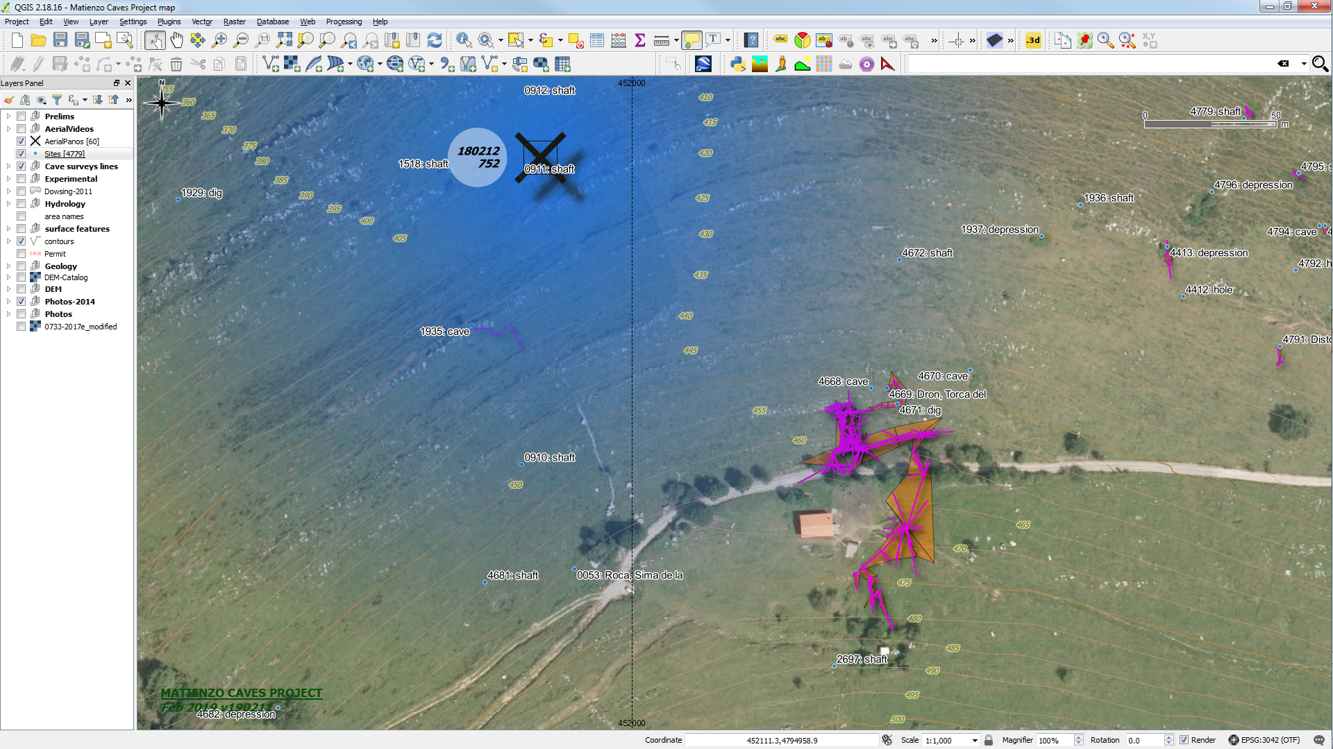

Slide 26
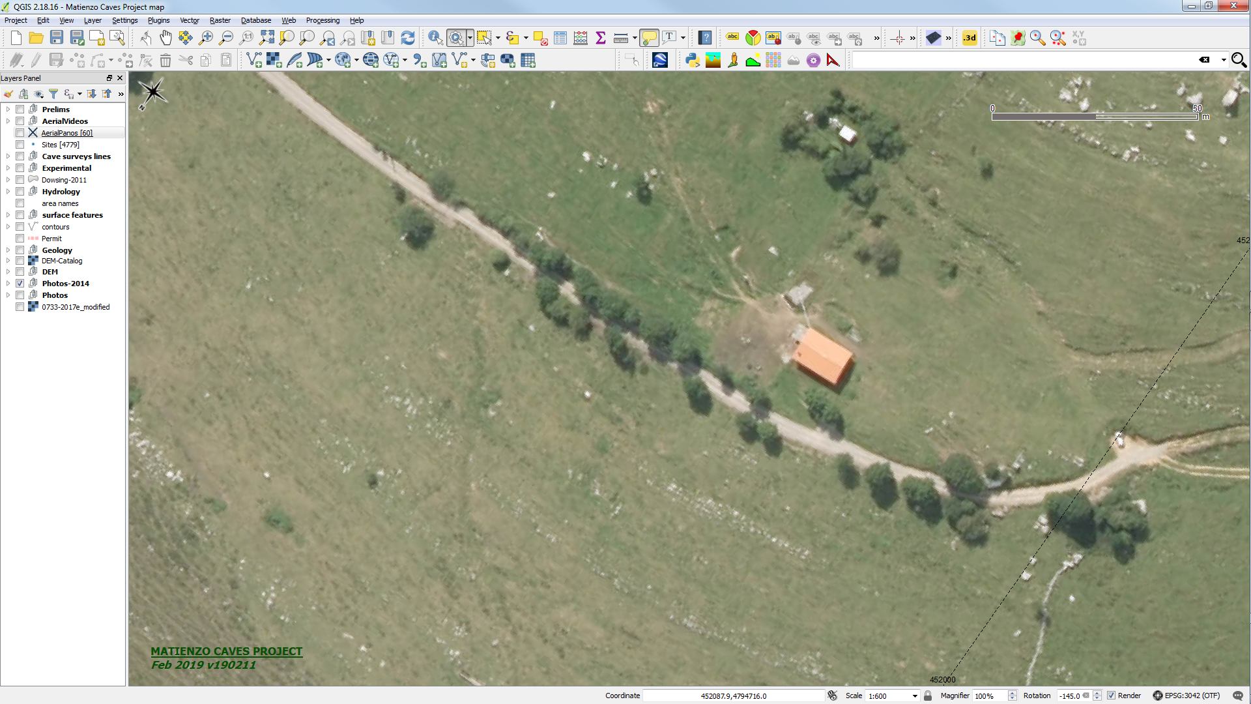

Slide 27
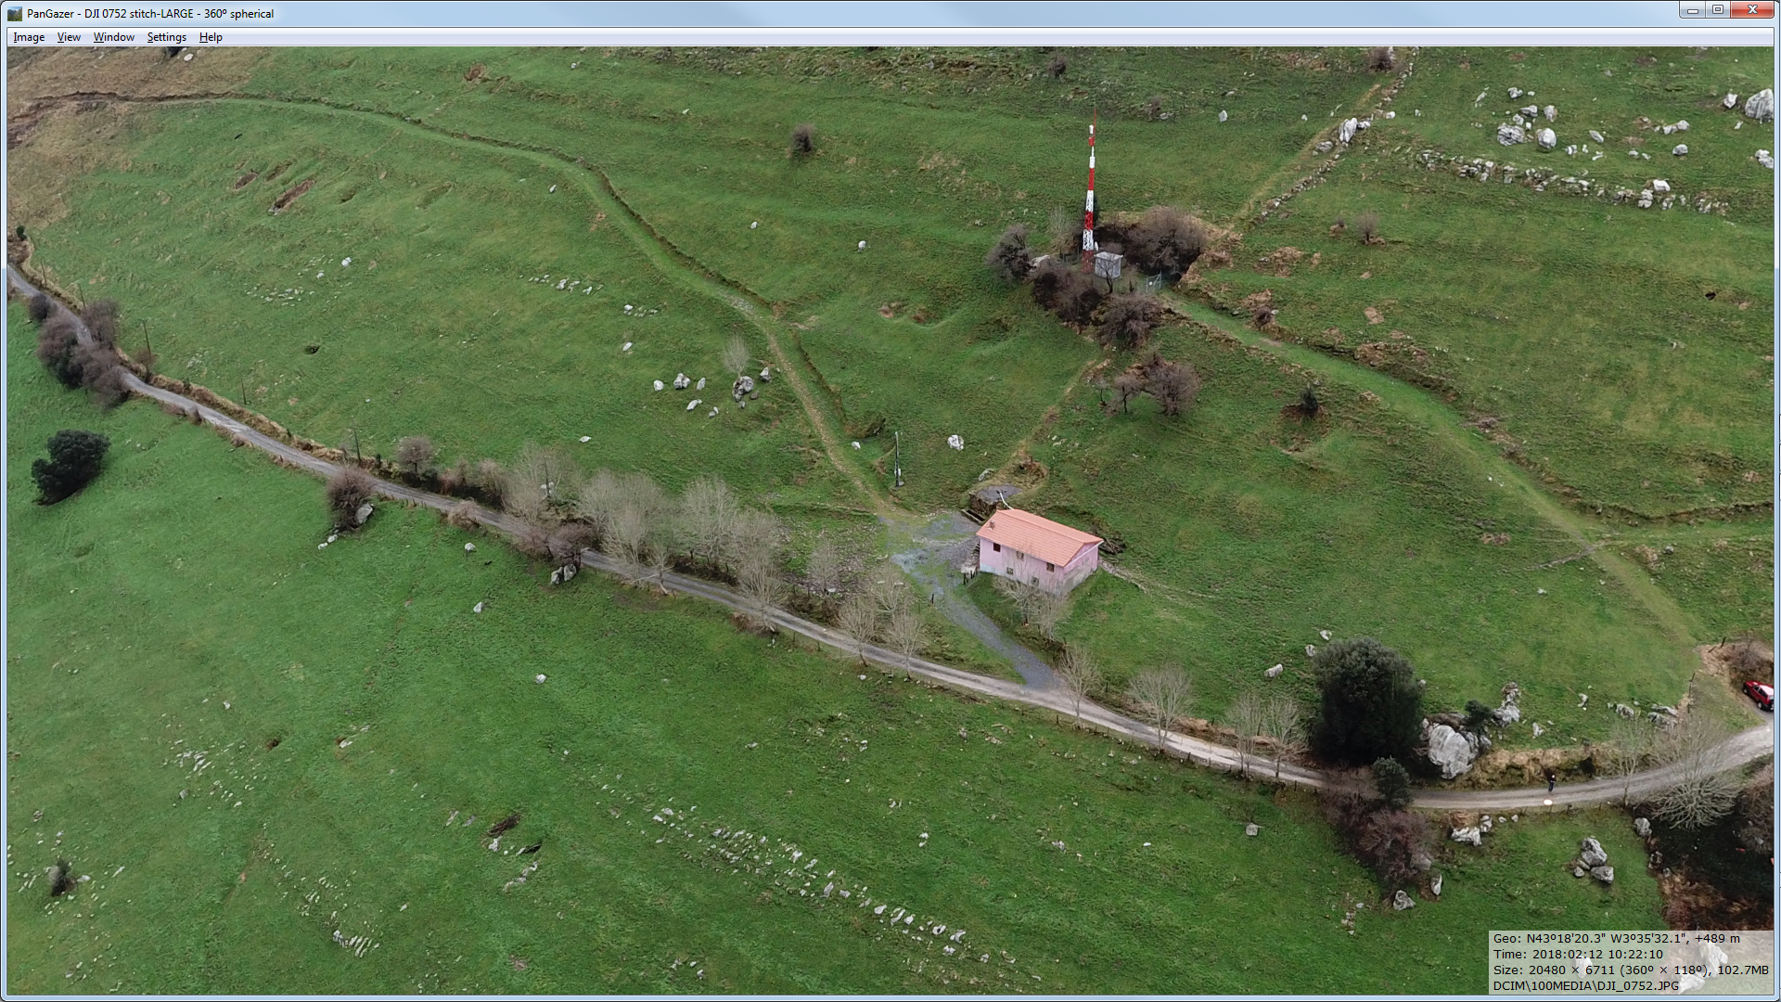

Slide 29
NEW BOOK
Matienzo Caves: The next 10 years, 2010 - 2019
Publication date: July 2020
Editors: Juan Corrin, Phil Papard
Translator: Carolina Smith de la Fuente
Proof reader: Harry Long
Dual language : possibly 300 pages

Slide 30
MAIN ARTICLES
Expeditions 2010 - 2012 (Juan)
Expeditions 2013 - 2019 (Juan)
Cave diving update (Phil Papard)
Archaeology update (Pete Smith)
Chris Scaife Diaries (2013 - 2018)
Cueva Del Bosque Extensions 2017 (Neil 'Slim' McCallum)
The Glasses (Alasdair Neill appreciation piece) (Peter Eagan)
Explorations in Torca la Vaca with Doldy (Johnny & Jude)
Explorations in Torca del Dron (Bill Nix)
"Something relating to Lenny Gee" (Nigel Dibben)

Slide 31
MAIN ARTICLES
Calamity Jane (Jane Chilton)
Vaca Back Door - the connection dig from inside (Di)
Explorations in Urros (Di)
Recent explorations in Fresnedo 2 (James)
Poss. Paul Dold appreciation piece (Badger & Footleg)
Washing Machine Hole (Alex Ritchie - with Phil Parker?)
"Something" - Phil Goodwin
Lancaster University Projects Climate & Neanderthals; new project? (coord. Peter Wynn)
MKEP - Bugs overview and some detail (Tom Thomson)
Hydrology water tracing with maps (Juan)

Slide 32
MAIN ARTICLES
Where Have All the Un-explored Caves Gone? (Harry Long)
[ Possible Hypogene Caves (Peter Smith) ]
Science: new Technology & software: IR, drone, Disto X, Dowsing, radon, QGIS map (Juan)
Continuing explorations in Cueva Llanío (Torben and Louise)
"Deciding on subject matter" (Phil Parker & Nigel Easton)

Slide 33
SMALLER PIECES
Effect of Brexit on the Expeditions, if any (Juan)
Ascending 117m with a venomous reptile (Chris Scaife)
The Ring (Vaca Sump) (Simon)
The Wedding (Chris Scaife)
Expeditions - Then and Now (Pat Devine)
My First Day (Amata Hinkle)

Slide 34
Use the maps software, data & drone pics to spot possible sites.
Ways to help Tom and the entomology project
Offers of book articles or anecdotes (or retractions?!)
New logo for 60th year?

